Slide 1
Alternative Reference Rates
Kučera & Novák

Slide 2
Summary of ARRs
Based on actual transactions
The transaction volumes used for SOFR calculation regularly over $2 trillion in daily volumes
Calculated by volume-weighted median
Each country has its own rate calculation mechanism
Overnight only, backward looking rates with limited forward term structure
A compound average of ARRs will accurately reflect movements in interest rates over a given period of time

Slide 3
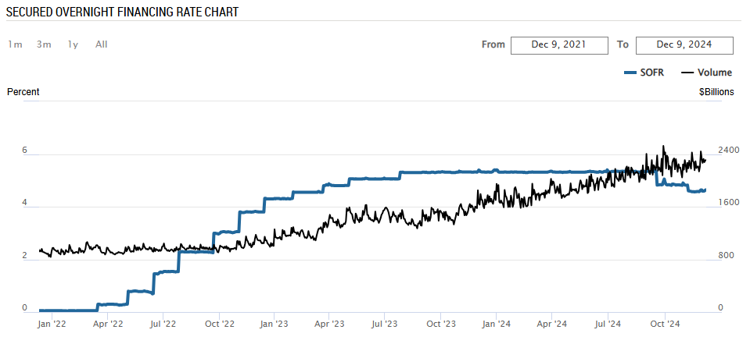
SOFR and its Volume

Slide 4
Summary of ARRs
Based on actual transactions
The transaction volumes underlying SOFR regularly over $2 trillion in daily volumes
Calculated by volume-weighted median
Each country has its own rate calculation mechanism
Overnight only, backward looking rates with limited forward term structure
A compound average of ARRs will accurately reflect movements in interest rates over a given period of time

Slide 5
Summary of differences between LIBORs and ARRs
LIBOR
ARRs
Forward looking rate with the defined term structure (7 tenors)
Overnight only, backward looking rates with limited forward term structure
Based on expectations and often expert judgement; quotes submitted by panel banks
Based on actual transactions; calculated volume-weighted median
Centrally calculated in the London Interbank market for 5 currencies
Each country has its own rate calculation mechanism

Slide 6
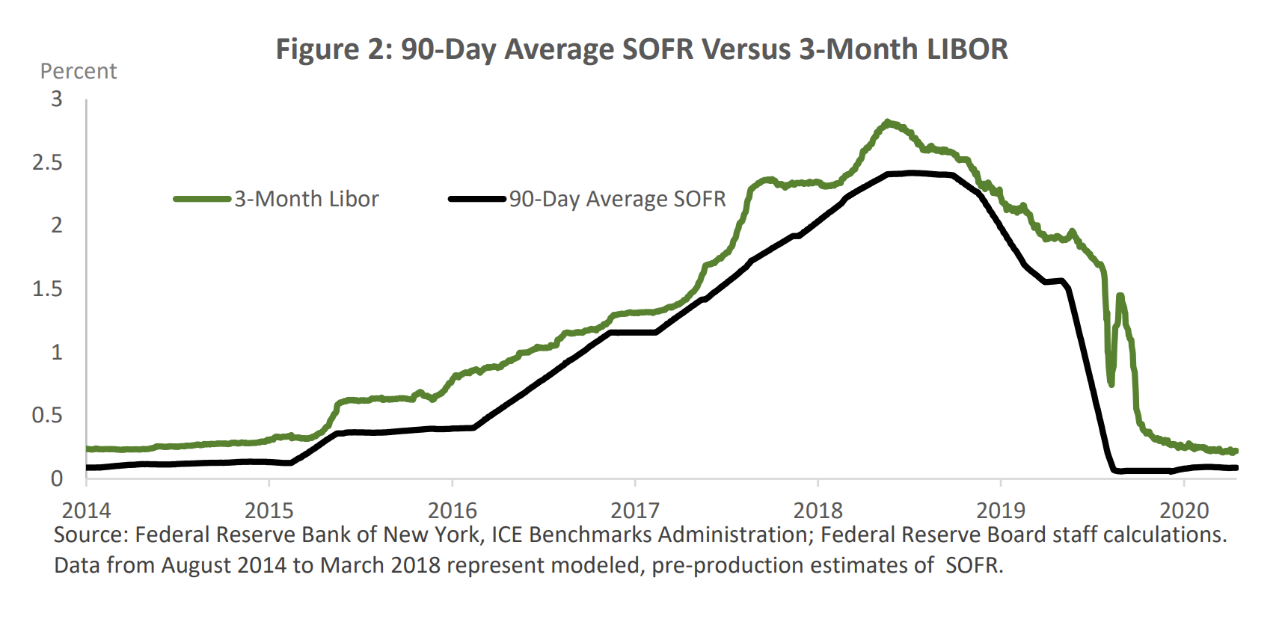

Slide 7





Introduction to nearly Risk-Free Rates (RFRs)
Transition
LIBOR
USD LIBOR
EUR LIBOR / EONIA
GBP LIBOR
CHF LIBOR
JPY LIBOR
ARRs
SOFR
Secured Overnight Financing Rate
€STR
Euro Short-term Rate
SONIA
Sterling Overnight Index Average
SARON
Swiss Average Rate Overnight
TONAR
Tokyo Overnight Average Rate
RFR ≠ IBOR
Secured Overnight Financing Rate
Euro Short-Term Rate
Sterling Overnight Index Average
Swiss Average Rate Overnight
Tokyo Overnight Average Rate
  Fully transaction based
  Secured overnight rate with robust underlying money market
  Fully transaction based
  Reflects the unsecured wholesale Euro borrowing costs euro banks
  Fully transaction based
  Unsecured overnight rate with robust underlying money market
  Txn. based + quotes
  Secured overnight rate since 2009 reflecting interest paid on repo
  Fully transaction based
  Unsecured rate reflecting based on the overnight call rate market
  Fully transaction based: Means that these rates are based on the actual rates used for the transactions in the selected O/N markets. For e.g., SOFR is based on the transactions in the Treasury repo market.
  Unsecured / Secured Rates: When the rates are based on collateralized (secured) money market instruments, they are referred to as secured rate. For e.g., SOFR is a secured rate, based on transactions that involve collateral, in the form of Treasuries.

Slide 8
CZEONIA
Czech Overnight Index Average
Weighter average of interest rates of all unsecured overnight deposits made by banks and foreign bank branches on the interbank market
Not widely used

Slide 9
CZEONIA
Czech Overnight Index Average
Weighter average of interest rates of all unsecured overnight deposits made by banks and foreign bank branches on the interbank market
Not widely used
1 day PRIBOR
1 day CZEONIA

Slide 10
CZEONIA
Czech Overnight Index Average
Weighter average of interest rates of all unsecured overnight deposits made by banks and foreign bank branches on the interbank market
Not widely used
4.00 %
(10. 12. 2024)
1 day PRIBOR
1 day CZEONIA

Slide 11
CZEONIA
Czech Overnight Index Average
Weighter average of interest rates of all unsecured overnight deposits made by banks and foreign bank branches on the interbank market
Not widely used
4.00 % 3.68 %
(10. 12. 2024) (11. 12. 2024)
1 day PRIBOR
1 day CZEONIA

Slide 12
Technical Aspects of ARRs

Slide 13


Interest Calculation Methodology for ARRs
LIBOR
1M LIBOR + Margin (C/F known in advance)
Coupon date
Sep 1
Oct 1
1M LIBOR fixed on Sep 1 for the duration of the interest period
ARR
C/F not known in advance
ARR + Margin
Lookback
T – 5 BD
Lookback
T – 5 BD
Coupon date
Aug 27*
Sep 1
ARRs are obtained daily and compounded in arrears at the end of the interest period
Sep 26*
Oct 1
Interest Rate Period
Cashflow Period
*Illustrative dates

Slide 14
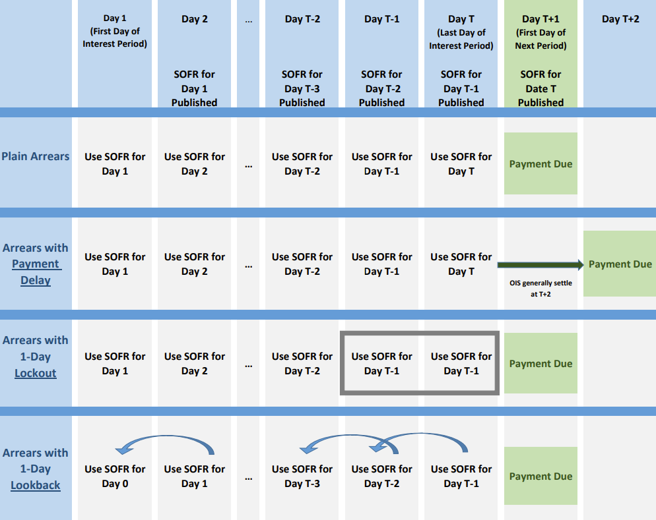
Other conventions

Slide 15

Compound Interest Average
$i=\left[\prod_{b=1}^{T}{\left(1+\frac{r_{b}n_{b}}{N}\right)}−1\right]\frac{N}{d}$
$T$ = the number of business days in the interest period
$d$= the number of calendar days in the interest period
$r_{b}$= the interest rate applicable on business day $b$
$n_{b}$= the number of calendar days for which rate $r_{b}$ applies
$N$ = the market convention

Slide 16
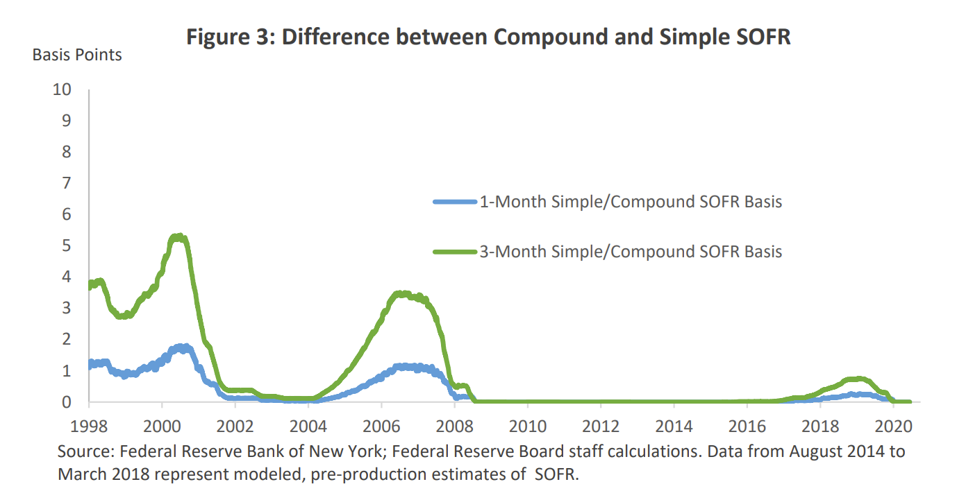

Slide 17
Lookback with / without observation shift – rate weights
Lookback without observation shift:
Weighs the rate according to the number of days in the rate observation period
Weight:
5 days
Weight:
1 day
Weight:
1 day
Tue | Wed | Thu | Fri | Sat | Sun | Mon | Tue | Wed | Thu | Fri | Sat | Sun | Mon | Tue | Wed | Thu
31 | 1 | 2 | 3 | 4 | 5 | 6 | 7 | 8 | 9 | 10 | 11 | 12 | 13 | 14 | 15 | 16
Weight:
1 day
Weight:
3 days
Weight:
1 day
Weekend/holiday
Working day
Lookback with observation shift:
Weighs the rate according to the number of days in the interest rate period

Slide 18
Sources
https://www.newyorkfed.org/medialibrary/Microsites/arrc/files/2021/users-guide-to-sofr2021-update.pdf
https://www.newyorkfed.org/markets/reference-rates/sofr
https://www.bankofengland.co.uk/markets/sonia-benchmark
https://www.cnb.cz/en/financial-markets/money-market/czeonia-reference-interest-rate/
https://www.nortonrosefulbright.com/en/knowledge/publications/5949ea18/libor-and-risk-free-rates-frequently-asked-questions
https://www.ecb.europa.eu/stats/financial_markets_and_interest_rates/euro_short-term_rate/html/index.en.html
https://www.six-group.com/en/market-data/indices/switzerland/saron.html
https://tradingeconomics.com/japan/overnight-interbank-average-rate

